Slide 1
MTC DSRC demo
Takchoi Yu
Song wang
Cheng Liu
Oct 23, 2017

Slide 2
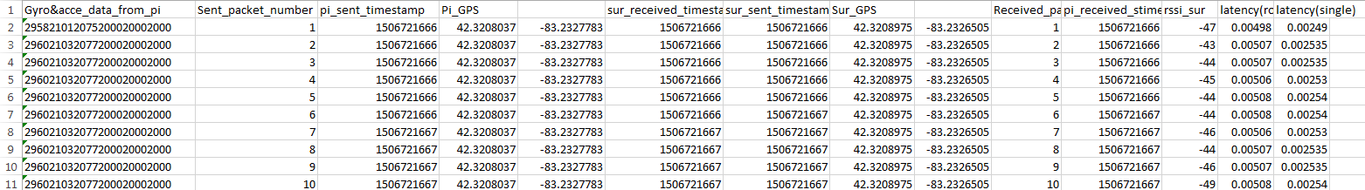
DSRC Demo - DSRC_test_9-29-2017 raw data

Slide 3
DSRC Demo - DSRC_test_9-29-2017
Attribute name | Description
Gyro&acce_data_from_pi | Roll/pitch/yaw/ax/ay/az
Sent_packet_number | DSRC sent packet number
pi_sent_timestamp | DSRC (Raseberry Pi side) packet sent timestamp
Pi_GPS | Raseberry Pi GPS(lat,long)
sur_received_timestamp | DSRC (Surface_Pro side) packet received timestamp
sur_sent_timestamp | DSRC (Surface_Pro side) sent timestamp
Sur_GPS | Surface_Pro GPS(lat,long)
Received_packet_number | DSRC return packet number
pi_received_stimestamp | DSRC (Raseberry Pi side) packet received timestamp
rssi_sur | Signal strength
latency(round) | DSRC return transmission latency
latency(single) | DSRC single trip transmission latency

Slide 4
Demo program
v2pAnimation2.m
Input: prediction result GPS lat, long, speed, heading from both vehicle and pedestrian
Output: plot of the predicted path and warning zone

Slide 5
Warning zone criteria
rV – radius of vehicle warning zone
rP – radius of pedestrian warning zone
speedV – predicted speed of vehicle
speedP – predicted speed of pedestrian
rV = speedV * 5 + 15;
rP = speedP * 4 + 15;
Collision warning Criteria
(rP + rV)*0.25 > distance between the predicted location of Pedestrian and Vehicle

Slide 6
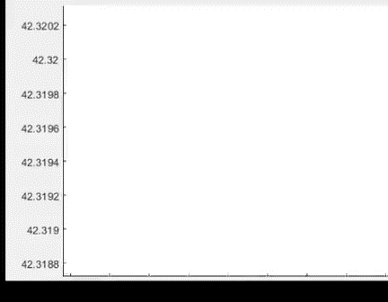
Red : vehicle ground truth
Blue : pedestrian ground truth
Green : vehicle 1s position prediction & warning zone
Light blue : pedestrian 1s position prediction & warning zone

